Slide 1

Scan to Email Configuration
First find the IP address of your device.

Slide 2
Scan to Email Configuration
Next, Enter the IP address found in previous slide into the address bar of a web browser.
Once there, Login in with Username of admin and no password.
If changed, please log in with changed credentials.
Hover over Device Management and select Configuration.
Then select the Option for Email.

Slide 3
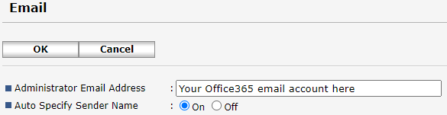
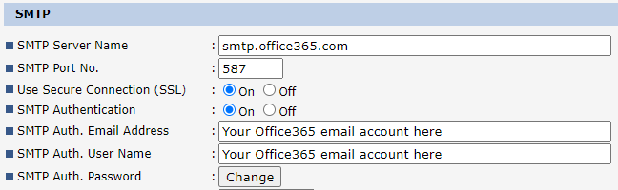
Scan to Email Configuration
Microsoft Office365.
The Email account you use for authentication will need to be a licensed.
SMTP auth may need to be enabled in this account if you get authentication failed message.

Slide 4
Scan to Email Configuration
Microsoft Office365 enable SMTP auth.
Use the Microsoft 365 admin center to enable or disable SMTP AUTH on specific mailboxes
Open the Microsoft 365 admin center (https://admin.microsoft.com) and go to Users > Active users.
Select the user, and in the flyout that appears, click Mail.
In the Email apps section, click Manage email apps.
Verify the Authenticated SMTP setting: unchecked = disabled, checked = enabled.
When you're finished, click Save changes.
Note: If your Office365 Administrator has a global policy to disable SMTP auth, activating it here will not work. You must contact your Administrator for assistance.

Slide 5
Scan to Email Configuration
Microsoft Office365 relay setup for older devices.

