Slide 1

Scan to Email Configuration
First find the IP address of your device.

Slide 2
Scan to Email Configuration
Next, Enter the IP address found in previous slide into the address bar of a web browser.
Once there, Login in with Username of admin and no password.
If changed, please log in with changed credentials.
Hover over Device Management and select Configuration.
Then select the Option for Email.

Slide 3
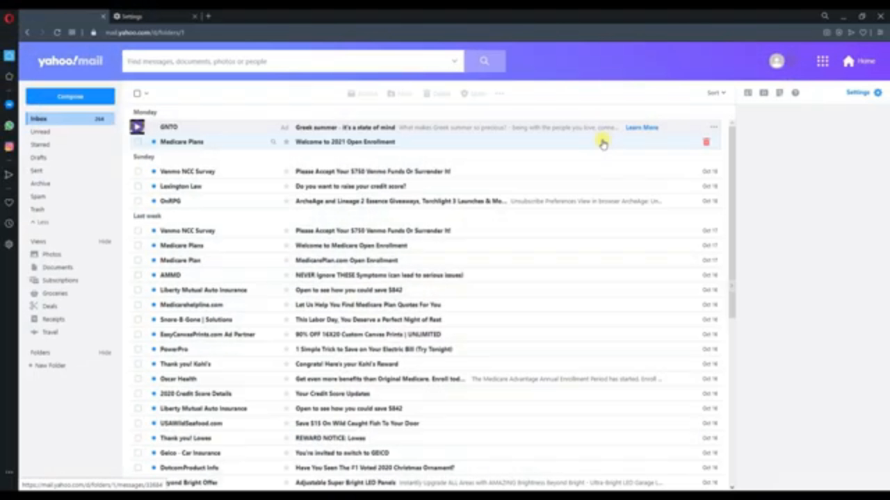
Scan to Email Configuration
How to create your App Password in Yahoo.
Use this password in the Ricoh device for scanning.

Slide 4
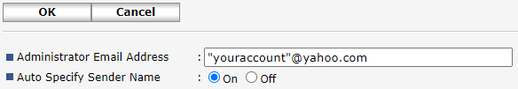
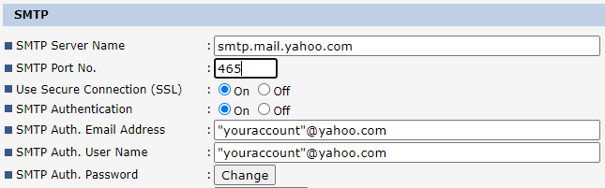
Scan to Email Configuration
Yahoo.
Use the App Password you created on the previous slide for the SMTP Auth. Password.

