Slide 1

Scan to Email Configuration
First find the IP address of your device.

Slide 2
Scan to Email Configuration
Next, Enter the IP address found in previous slide into the address bar of a web browser.
Once there, Login in with Username of admin and no password.
If changed, please log in with changed credentials.
Hover over Device Management and select Configuration.
Then select the Option for Email.

Slide 3
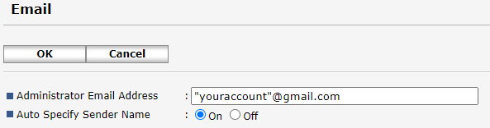
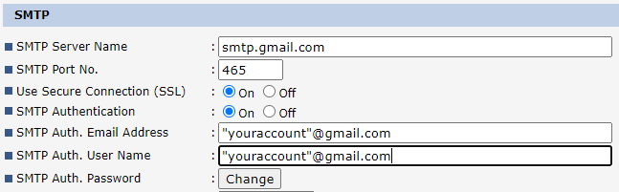
Scan to Email Configuration
Gmail.
You will need to choose one of the next 2 slides on how you would like to authenticate from your Google account.
Whether you are using 2 step verification or not.

Slide 4
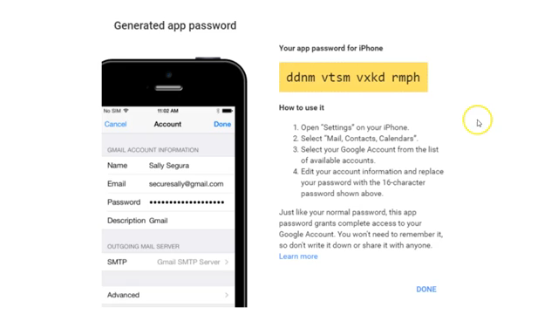
Scan to Email Configuration
Gmail using 2 step verification.

Slide 5
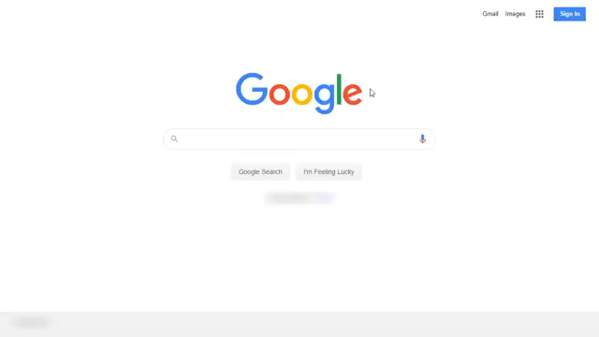
Scan to Email Configuration
Gmail not using 2 step verification.

